Slide 1

Notes:
Two years ago, I went to a tech conference in the US and had a big revelation about what it means to have a good presentation.
A good presentation is not about how impressive or smart your work is. But about how you present it such that the audience can keep their attention and think “Wow that was interesting, I want to know more about this”.

Slide 2
An introduction to
Delivering Technical Presentations with Confidence
Notes:
In this presentation we will cover 3 concepts: 1. How to structure your story
2. How to create your slidedeck
3. How to present with confidence
I will share my tips & tricks that I collected over the years and wish I knew when I started.

Slide 3

Tips for online presentations
Notes:
More presentations are given online at the moment. In the presentation I will give some tips to tweak your presentation for an online audience

Slide 4
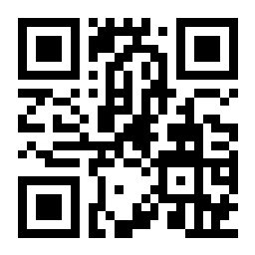
https://app.sli.do/event/ne2wqmyk
Join at slido.com
#U171
Notes:
We will be using Slido to keep the session more interactive and engaging.

Slide 5

Describe your last meeting/presentation in one word
ⓘ Start presenting to display the poll results on this slide.
Notes:
📣 This is Slido interaction slide, please don't delete it. ✅ Click on 'Present with Slido' and the poll will launch automatically when you get to this slide.

Slide 6
In the last presentation you attended, did you look at your phone or screen?
ⓘ Start presenting to display the poll results on this slide.
Notes:
📣 This is Slido interaction slide, please don't delete it. ✅ Click on 'Present with Slido' and the poll will launch automatically when you get to this slide.

Slide 7



Notes:
4 out of 5 business professionals shifted their focus away from the speaker in the most recent presentation they watched
https://blog.prezi.com/the-state-of-attention-2018-infographic/

Slide 8
The success of your presentation will be judged not by the knowledge you send but by what the listener receives.
- Lilly Walters
“

Slide 9
The success of your presentation will be judged not by the knowledge you send but by what the listener receives.
- Lilly Walters
“
Notes:
For a successful presentation, it is your job as a speaker to make sure the listener can easily absorb the information.

Slide 10

Structuring your story
Notes:
The steps we will describe can also be found on the PyLadies repository. Use this the next time even before you create your slide deck.

Slide 11
Who is the listener?
Notes:
Who is your audience?
What is their background?
What do they already know about the topic? What would they be interested in?
Every presentation gets tweaked for a different audience

Slide 12
WIIFY
Notes:
WIIFY

Slide 13
WIIFY
(What’s in it for you?)
Notes:
What’s in it for you? Why should the audience care?
Make it clear to the audience in the beginning of your presentation, don’t save it until the end. If they know why it is relevant for them, it’s easier to stay focused.

Slide 14

One main takeaway
Notes:
If you would have 60 seconds on stage, what would you say?
If your audience could only remember one thing, what should that be?
Use this to guide the whole presentation. Everything will contribute to this one main takeaway. You can also use this as the closer of your presentation.

Slide 15
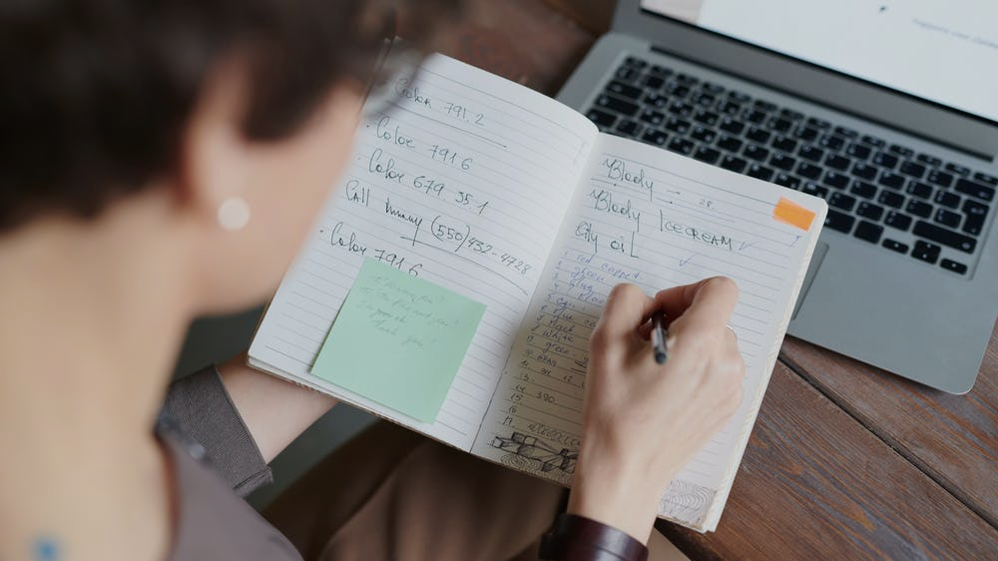
Notes:
Write down everything you can think of that can be included in your talk. Add examples, stories, visuals, write everything down, nothing is too crazy. Be detailed.
Group everything in categories or concepts. People remember grouped information better

Slide 16

Divide into three concepts
Notes:
People’s working memory cannot hold that much new information. Preferably choose three concepts for your presentation. How big the concepts are depend on your presentation.

Slide 17
On average, how long can an audience keep their attention?
ⓘ Start presenting to display the poll results on this slide.
Notes:
📣 This is Slido interaction slide, please don't delete it. ✅ Click on 'Present with Slido' and the poll will launch automatically when you get to this slide.

Slide 18

Your average attention: 10 minutes

Slide 19
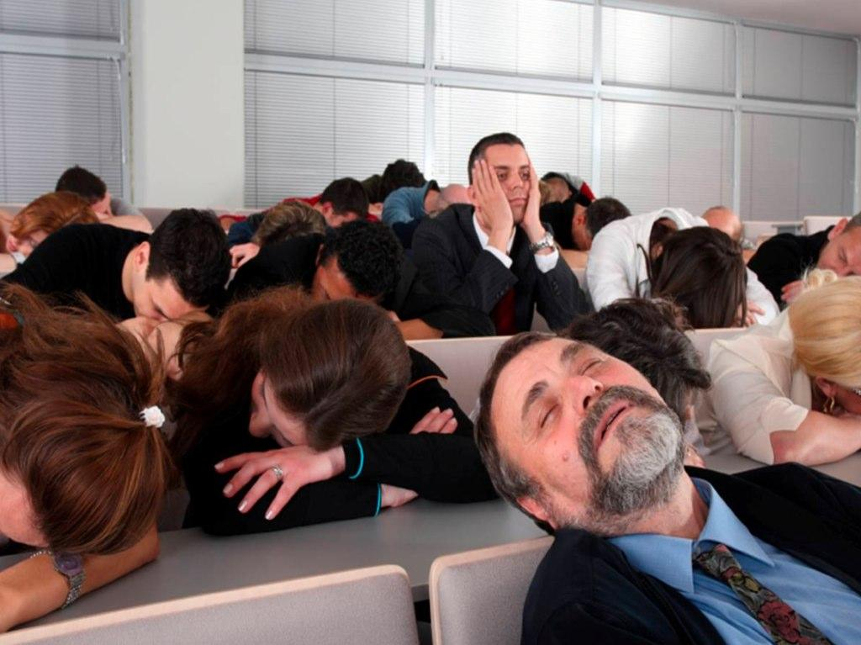
Re-engage your audience
Notes:
Re-engage your audience every 10 minutes:
Mini-break (after 45-60 min it’s always good to have a break)
Do something interactive
Move to a different topic
Tell a story
Ask the audience a question
Do a demo (you don’t have to wait until the end)

Slide 21
Re-engage your audience
with questions
Notes:
Attention span in an online audience is even shorter. Re-engage the audience by asking them questions (see the Slido examples)

Slide 23

Creating your slides
Notes:
Bad slides can really distract your audience.

Slide 24
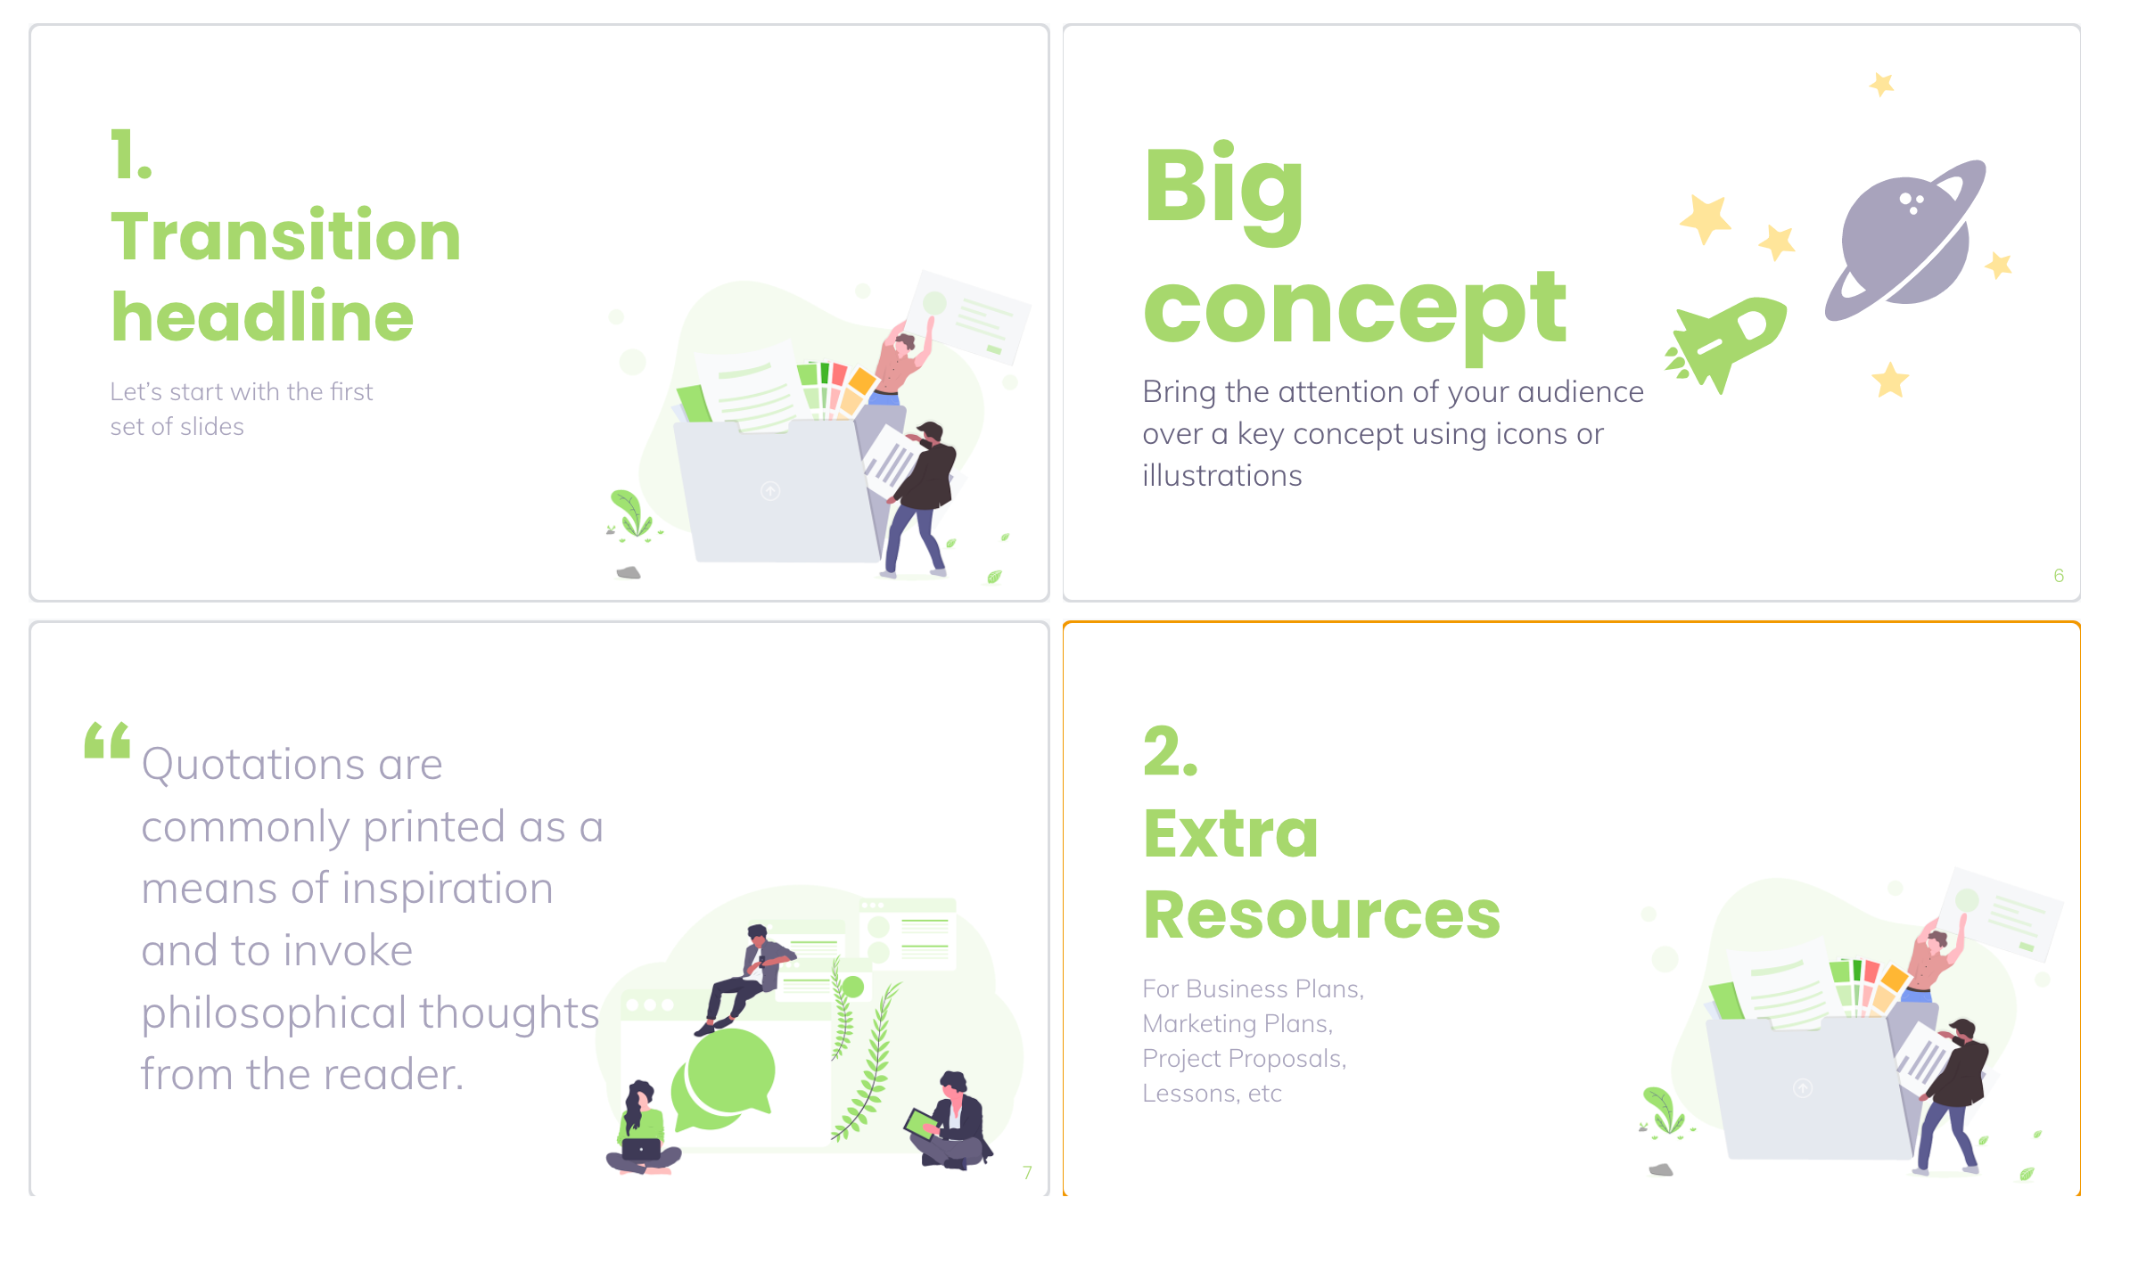
Notes:
How many slides do you need?

Slide 29
Why is having too much text on a slide a bad thing?
People read.
So what happens to a person when they see a lot of text on a slide? They start reading what is on it. Because they need to digest it. That means their attention will stay on the slide until they’ve read it all.
When your audience reads, they don’t hear you
Now try this: have someone tell you something, while you are trying to read something for the first time. You will either fail to read or fail to listen. You can’t do both.
The same will happen with your audience, they will focus on one thing. And that one thing is going to be the text. Their eyes will be drawn to the screen and will read, and won’t listen to you.
Your audience starts writing
I’m assuming that what you put on your slide is valuable information. Information that will help your audience. Your audience will feel the same way. It must be important because the speaker has put it on there!
When people come to an event or when they are listening to a speech, they want to remember things. And to remember, they will write things down. This means that when you put text on a slide, chances are your audience will write down what’s on your screen.
And you’ve guessed it. When they are writing, it’s hard to listen to you!
Too late
Especially when you have quite a bit of information on your slide, it will be hard for people to keep track of what you are saying. Chances are they will still be writing when you click to the next slide. That will mean they won’t hear the first things you are saying on a new topic.
They are playing catch up
The result is that people are playing catch up all through your presentation. They want to hear everything you say. They want to write down your message and your tips. But let’s put it bluntly: you’re not letting them.
(excerpt from https://www.speakwithpersuasion.com/lot-of-text-on-slides/)
Notes:
The number of slides is not important. It’s important how much (or actually how little) is ON the slides!

Slide 30
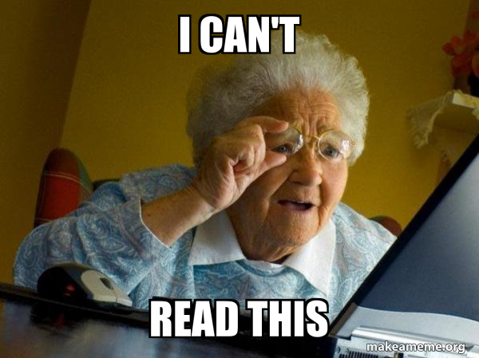

Slide 31
Why is having too much text on a slide a bad thing?
People read.
So what happens to a person when they see a lot of text on a slide? They start reading what is on it. Because they need to digest it. That means their attention will stay on the slide until they’ve read it all.
When your audience reads, they don’t hear you
Now try this: have someone tell you something, while you are trying to read something for the first time. You will either fail to read or fail to listen. You can’t do both.
The same will happen with your audience, they will focus on one thing. And that one thing is going to be the text. Their eyes will be drawn to the screen and will read, and won’t listen to you.
Your audience starts writing
I’m assuming that what you put on your slide is valuable information. Information that will help your audience. Your audience will feel the same way. It must be important because the speaker has put it on there!
When people come to an event or when they are listening to a speech, they want to remember things. And to remember, they will write things down. This means that when you put text on a slide, chances are your audience will write down what’s on your screen.
And you’ve guessed it. When they are writing, it’s hard to listen to you!
Too late
Especially when you have quite a bit of information on your slide, it will be hard for people to keep track of what you are saying. Chances are they will still be writing when you click to the next slide. That will mean they won’t hear the first things you are saying on a new topic.
They are playing catch up
The result is that people are playing catch up all through your presentation. They want to hear everything you say. They want to write down your message and your tips. But let’s put it bluntly: you’re not letting them.
(excerpt from https://www.speakwithpersuasion.com/lot-of-text-on-slides/)
Notes:
It’s difficult to read and listen at the same time, especially if it is not in sync.

Slide 33
Distracts the audience
Notes:
The audience reads the information why you are talking. Because both information

Slide 34
Distracts the audience
Unreadable in the back

Slide 35
Distracts the audience
Unreadable in the back
Audience won’t remember
Notes:
If everything is on there, we will focus on nothing.
Listening to and reading new information requires multi-tasking (or switching tasks) and as a result the audience will remember less

Slide 37
People will read what’s on the slide
Notes:
Sometimes you want text, you can play with contrast to sync their reading with your story

Slide 38
People will read what’s on the slide
If they read, they don’t listen

Slide 39
People will read what’s on the slide
If they read, they don’t listen
Information on your slide might be important

Slide 40
People will read what’s on the slide
If they read, they don’t listen
Information on your slide might be important
If they write, they don’t listen

Slide 41
People will read what’s on the slide
If they read, they don’t listen
Information on your slide might be important
If they write, they don’t listen
They need to play catch-up
Notes:
Playing catch-up can feel exhausting

Slide 42
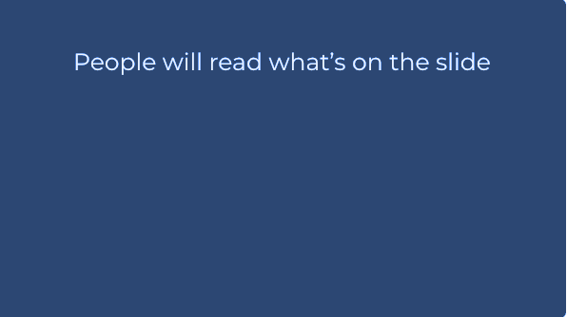
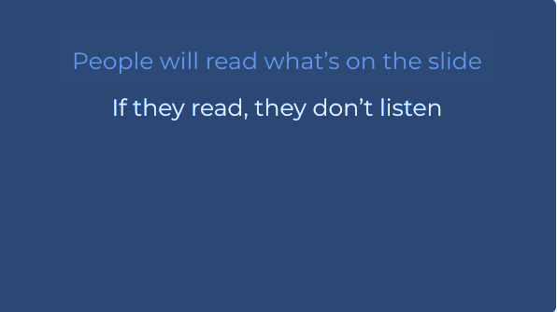
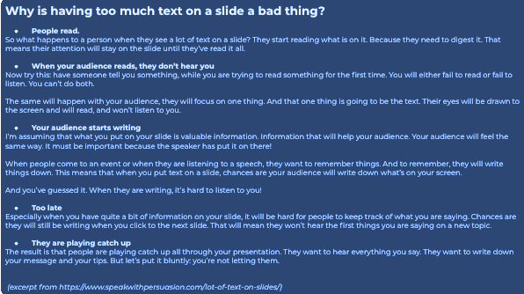
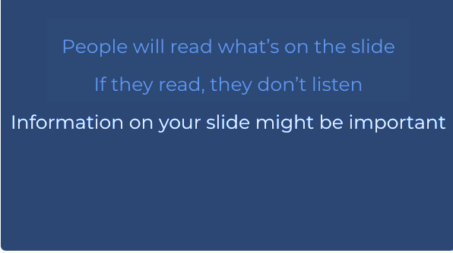
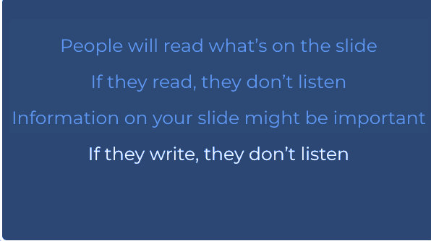
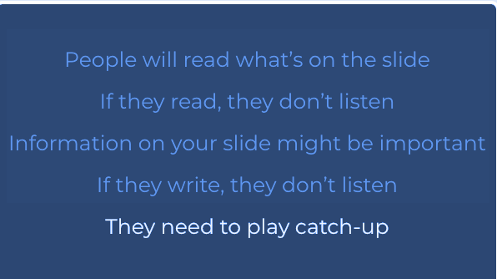
VS
Notes:
Five slides to display the same information can be better than 1.

Slide 43
Don’t let audience multi-task
Notes:
A single phrase can be even better. Your audience won’t get distracted that much. AND they won’t realize if you forgot to mention something

Slide 44



??
Notes:
See if you can find/make an image that nicely shows the point you want to make and use this slide during your story.

Slide 45
65 %
Notes:
Studies show that having a visual aid when hearing something, can boost your memory by 65%

Slide 46
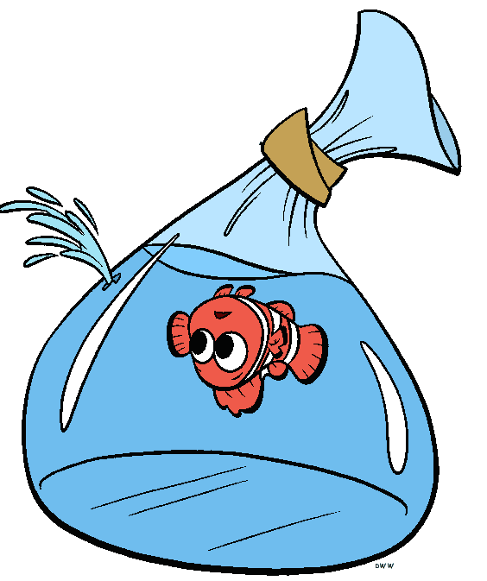
Notes:
BUT if you show an image that doesn’t relate to the topic and it’s hard to find the relation between the text and the image, it will become distracting

Slide 47
How can people understand
my slides later?

Slide 48
How can people understand
my slides later?
Speaker notes or handout
Notes:
If you to cram it in, it’s a document not a presentation.
The goal of a presentation is to deliver knowledge and inspire, not to read a document along with the audience.

Slide 49
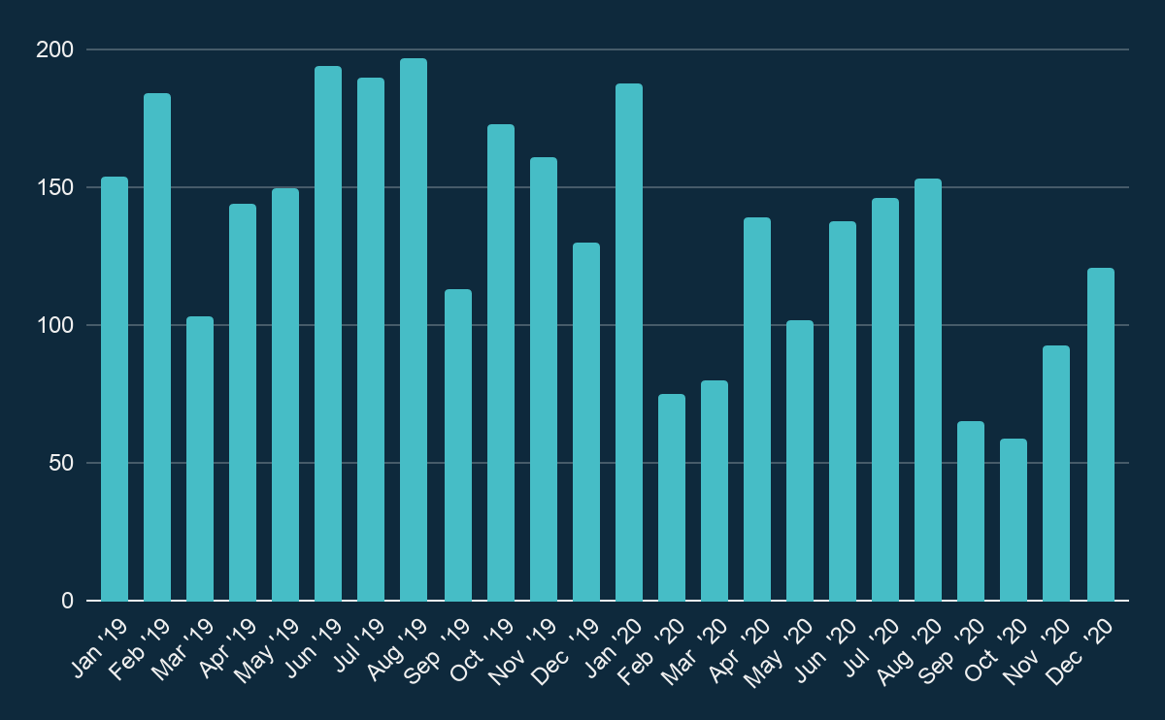
Notes:
Big graphs can be hard to focus on

Slide 50
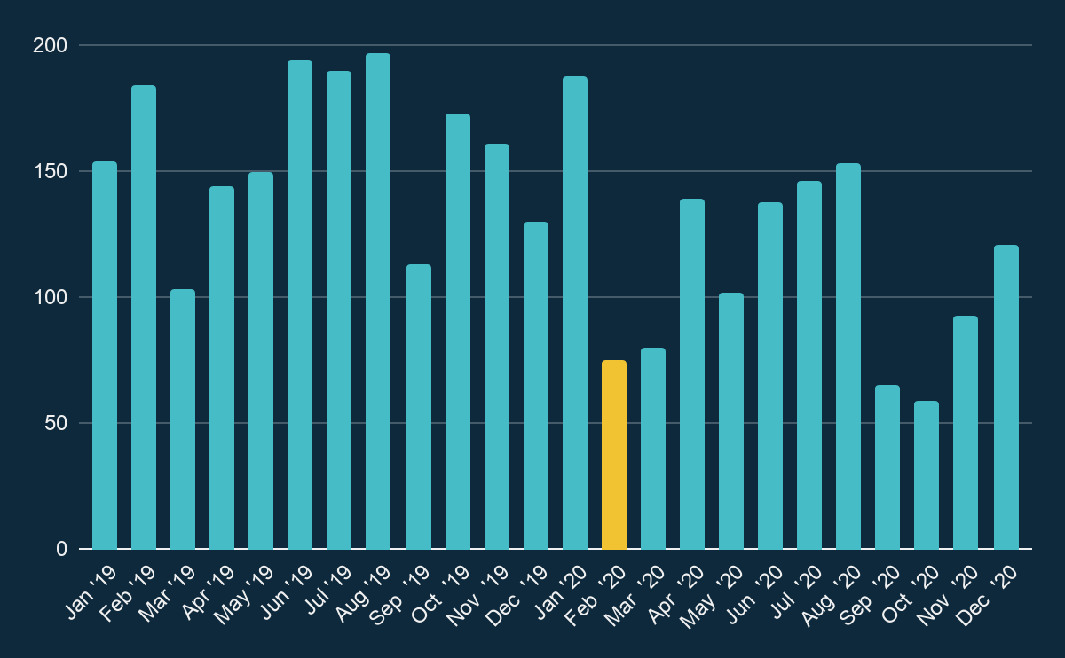
Notes:
By playing with contrast, you can MAKE the audience focus. This also works for line graphs

Slide 51
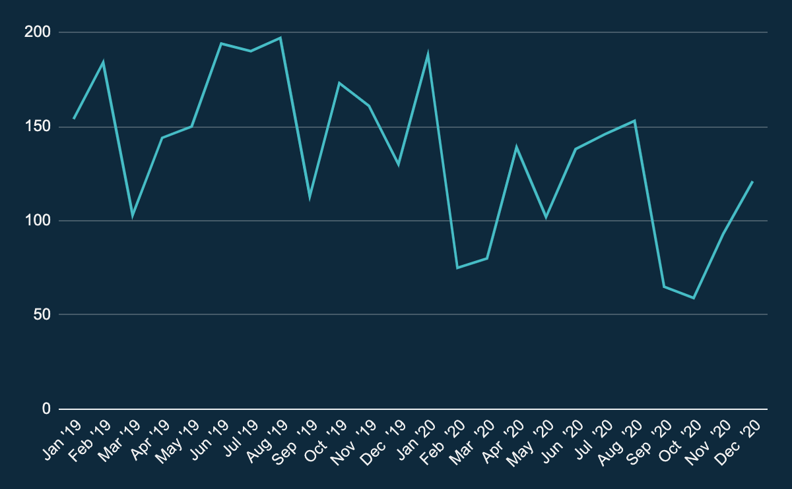
Notes:
Let’s take this one here. Now focus on the first 3 months of 2020…. Can you see it? Did you already lose it?

Slide 52
Notes:
By making the rest less visible, the audience can move immediately back to the part you want them to focus on.

Slide 53
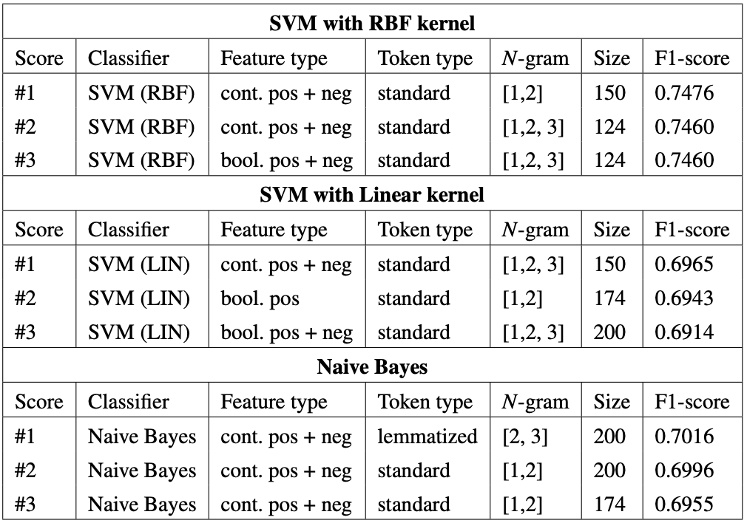
Notes:
Playing with focus also works with tables filled with results. It can feel quite overwhelming, especially if I want you to focus on 2 rows that are not close together.

Slide 54
Notes:
It should become immediately clear which results I am talking about now and what their scores were. And which was higher.
But this might still be a bit small to read in the back

Slide 55

Notes:
Let’s zoom in. Now I hope you have all your attention on these 2 scores. Even if you are sitting all the way in the back of the room.
And it’s quite simple to create. I make the lower image transparent, making it less visible for the eye. And I copy the image and zoom in to make it big on top.

Slide 56
# Imports.
from sklearn.linear_model import LogisticRegression
from sklearn.datasets import make_classification
from sklearn.model_selection import train_test_split
from sklearn.metrics.classification import precision_score, recall_score
# Create the dataset.
x,y = make_classification(n_samples=1000, n_features=20)
x_train, y_train, x_test, y_test = train_test_split( x, y, test_size=0.25)
x_train, y_train, x_test, y_test = splits
# Train the model.
lr = LogisticRegression()
lr.fit(x_train, y_train)
# Predict on the test set.
predictions = lr.predict(x_test)
# Evaluate the model.
precision = precision_score(y_test, predictions)
recall = recall_score(y_test, predictions)
print(f"Recall: {recall:.2f}, Precision: {precision:.2f}")
Notes:
And this wouldn’t be a pyladies meetup without showing some python code. You can also do tricks with contrast for you code. Let me show you a larger piece of code without any contrast.

Slide 57
# Imports.
from sklearn.linear_model import LogisticRegression
from sklearn.datasets import make_classification
from sklearn.model_selection import train_test_split
from sklearn.metrics.classification import precision_score, recall_score
# Create the dataset.
x,y = make_classification(n_samples=1000, n_features=20)
x_train, y_train, x_test, y_test = train_test_split( x, y, test_size=0.25)
x_train, y_train, x_test, y_test = splits
# Train the model.
lr = LogisticRegression()
lr.fit(x_train, y_train)
# Predict on the test set.
predictions = lr.predict(x_test)
# Evaluate the model.
precision = precision_score(y_test, predictions)
recall = recall_score(y_test, predictions)
print(f"Recall: {recall:.2f}, Precision: {precision:.2f}")
Notes:
Now this is directly copied from my editor. The different color patterns feel familiar and you see a clear difference between code and comments.
But it is still quite small and a lot to digest. Even if I would walk through the separate steps, your eyes will wander to another step. It can help more to break it in pieces and zoom in. Now let’s zoom in for creating the dataset

Slide 58
# Create the dataset.
x,y = make_classification(
n_samples=1000, n_features=20
)
x_train, y_train, x_test, y_test = train_test_split(
x, y, test_size=0.25
)

Slide 59
# Train the model.
lr = LogisticRegression()
lr.fit(x_train, y_train)

Slide 60
# Train the model.
lr = LogisticRegression()
lr.fit(x_train, y_train)
# Predict on the test set.
predictions = lr.predict(x_test)

Slide 61
# Evaluate the model.
precision = precision_score(y_test, predictions)
recall = recall_score(y_test, predictions)

Slide 62
# Evaluate the model.
precision = precision_score(y_test, predictions)
recall = recall_score(y_test, predictions)
print(f"Recall: {recall:.2f}, Precision: {precision:.2f}")
>>> Recall: 0.81, Precision: 0.2
Notes:
So I hope this showed how you can use more slides, bigger fonts and contrasts + transparency to guide the attention of your audience.

Slide 64
Take into account different devices
Notes:
Rules of font size and contrast still apply when people are looking at their screen.
Your audience might not be in the back of the room, but might look at your presentation on their phone! If you are now in the audience looking via your phone, send a message in the chat!
This is not the only think you need to think about. Next to another screen size, you don’t know the quality of their internet. I’ve found that how fun and engaging videos or gifs might be, if there is a lag, they are not enjoyable. So my tip for online presentations, try to avoid using videos or gifs

Slide 66

Presenting with confidence
Notes:
Communicating your story with confidence is important in keeping the attention of your audience. This doesn’t mean you actually have to be fully confident. FOR ME, I always feel like giving presentations is just like skydiving.

Slide 67
True or False?
It is more difficult for introverts to create a good presentation
ⓘ Start presenting to display the poll results on this slide.
Notes:
📣 This is Slido interaction slide, please don't delete it. ✅ Click on 'Present with Slido' and the poll will launch automatically when you get to this slide.

Slide 68
FALSE
It is more difficult for introverts to create a good presentation

Slide 69
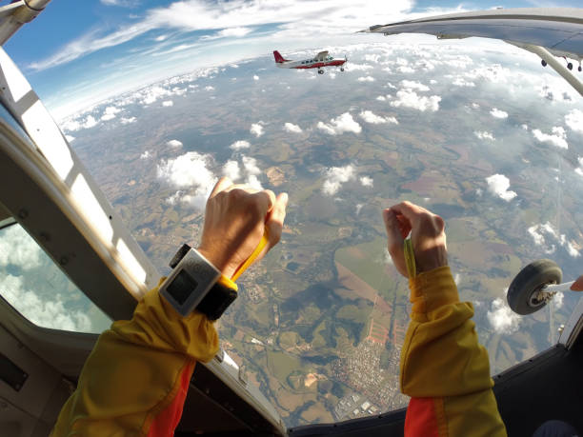
Notes:
Public speaking can feel like skydiving

Slide 70
Who had a fear of public speaking?
ⓘ Start presenting to display the poll results on this slide.
Notes:
📣 This is Slido interaction slide, please don't delete it. ✅ Click on 'Present with Slido' and the poll will launch automatically when you get to this slide.

Slide 71
There is no such thing as presentation talent,
it is called presentation skills
-David JP Phillips
“

Slide 72
There is no such thing as presentation talent,
it is called presentation skills
-David JP Phillips
“
Notes:
It’s a skill. It’s a skill that needs to grow and improve by practice. Which also means everyone can learn it, as long as you practice enough.

Slide 73
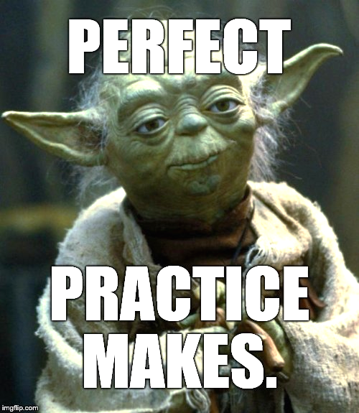
Notes:
In the words of yoda, perfect practice makes. This holds for the presentation itself, but also for your public speaking skills in general.
The more you practice the more confident you sound. It will become easier to remember your points and to speak freely
Practice in front of people to understand which points don’t come across. One of the most famous excellent public speakers was Steve Jobs. Turns out he started practicing 8 weeks before his presentation, with 2 full days of dress rehearsals.

Slide 74

Notes:
You can also practice by yourself at first. But make sure you make the movements with your mouth.You will notice what will flow and what does not. Where you get stuck and what doesn’t translate nicely.
So this might be some work, it’s definitely worth the time but sometimes you just don’t have enough time. If you don’t have enough time, practice your beginning and your end. These should be the most fluent to show confidence and grab the attention at the start and to end strongly. Then, if you have more time, practice transitions between topics.

Slide 75
Outline vs Script
Notes:
It depends. It depends on you.
I actually really like using a script. And scripted a lot for this presentation as well. I am not a natural storyteller. I struggle with making my point clear and concise, I get lost in my head. For me it really really helps to write down parts of the presentation. This way I can form powerful sentences to use at the important parts of the story.
Practice is key though. If you don’t practice enough, the script will become something you read word for word or can get stuck in. The more you can practice, the more natural it becomes. And don’t be afraid to deviate from the script.

Slide 76

Emergency plan
Notes:
Hope for the best, prepare for the worst.
Scenarios to prepare for:
Laptop can’t connect
No internet access (can’t use google slides for example)
Slow internet
Losing your train of thought

Slide 77

Notes:
How to connect with your audience

Slide 82
Notes:
If you have 4 friends that are there, ask them to sit in different parts of the room

Slide 84
Look at your audience webcam
Notes:
The audience will feel more connected if you look at your camera instead of at your screen to them.

Slide 85
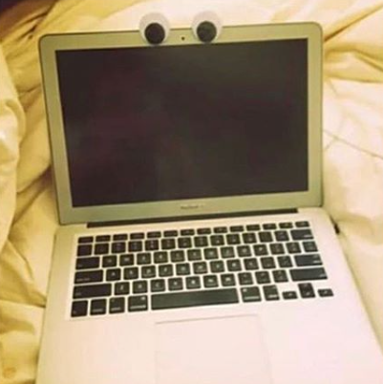
Notes:
Sticky notes or googly eyes can help you to remember while talking

Slide 87
Create the story for your audience

Slide 88
Create the story for your audience
Guide their attention in the slides

Slide 89
Create the story for your audience
Guide their attention in the slides
Practice to grow confidence

Slide 90
Make it easy for the audience
to focus on your story
Notes:
Make sure it is as easy as possible for your audience to focus and follow along in your story, so they will go home and think “Wow that was interesting, I want to know more!”

